Slide 1



ASSIGNMENT-1 FOR CAP100M: PROGRAMMING ORIENTATION
TOPIC: PRODUCT BASED AND SERVICE BASED COMPANY
Submitted By
Bibhukalyan Mohanty Regd No:-12201979
Roll No:- 09
Submitted To
Head Of Department Prof. BALRAJ KUMAR

Slide 2





What Is Product And Service Based Company
These are the companies that have their own products to sell.
A product is anything that can be offered to a market for attention.
A few product based company are:-
-Amazon
-Myntra
-Facebook
-Microsoft
A service-based IT company is driven by customer needs.
They offer services and solutions as per customer requirements.
A Few product based company are:-
Tech Mahindra
TCS
Wipro

Slide 3









Company Name
01
Microsoft
02
Infosys
Product Based Company
Service Based Company

Slide 4







Brief About the Company
Microsoft
Infosys
Microsoft is an American multinational computer technology corporation.
It produces consumer electronics, operating systems, and software.
Microsoft has now become the biggest software company.
Infosys is an Indian multinational information technology company.
It provides business consulting, information technology, and outsourcing services.
Infosys is the second largest Indian IT company after TCS by 2020 revenue.
01
01
02
02
03
03

Slide 5



Year of Existence with History
Microsoft
Infosys
Microsoft was founded on April 4, 1975.
Infosys Was Registered As Infosys Consultant Private Limited On 2nd July 1981.
01
01
It was founded by Bill Henry Gates and Paul Allen.
Infosys Was Founded By Seven Engineers In Pune, Maharashtra, India.
02
02

Slide 6





Country Of Origin And Countries For Business:
Microsoft
Infosys
01
Microsoft Corporation is an American multinational technology corporation headquartered at the Microsoft Redmond campus located in Redmond, Washington, United States.
Microsoft has offices across the world, Like
India Australia New Zealand
01
Infosys Limited is an Indian multinational information technology company.
Infosys operates its business in more than 54 countries.
These are some major countries :
India
South Africa USA
Europe
02
03
02

Slide 7



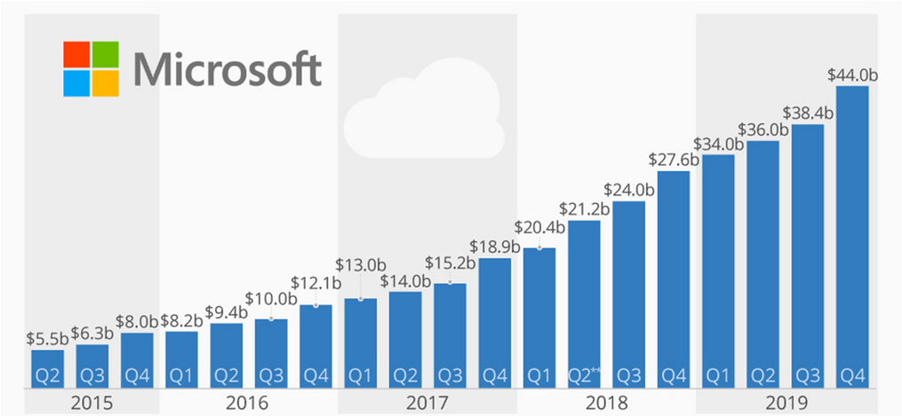
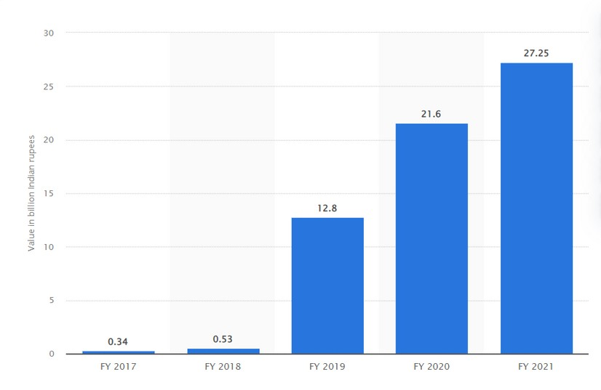




Revenue as per the NSE/ NYSE (Last 5 years)
2022:- $ 16.3 billion USD 2021:- $13.561 billion USD 2020:- $12.78 billion USD 2019:- $11.79 billion USD 2018:- $10.93 billion USD
Microsoft's annual revenue for 2022 was $198.27B, a 17.96%
increase from 2021.

Slide 8



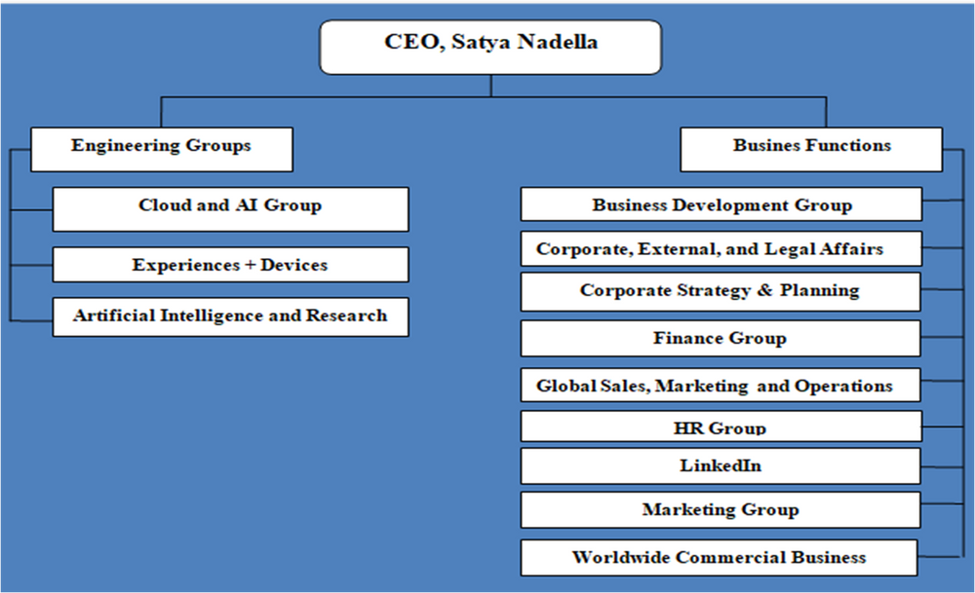
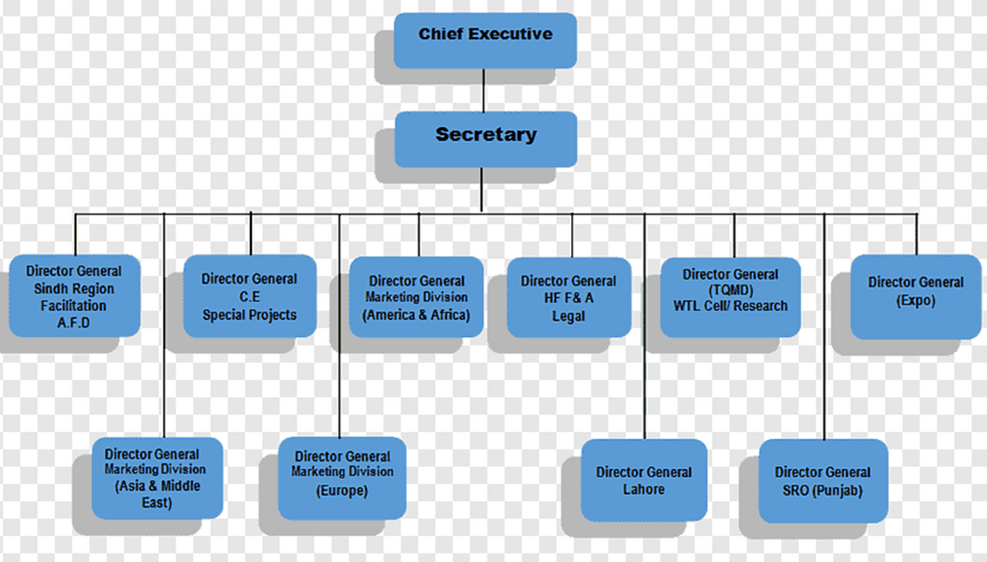
Leadership Hierarchy of the Company
Microsoft
Infosys

Slide 9



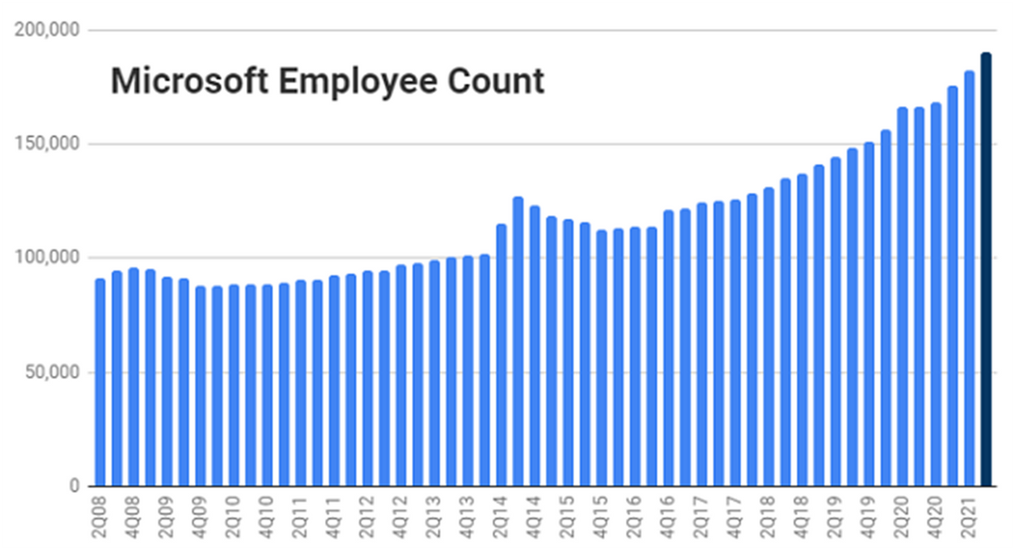
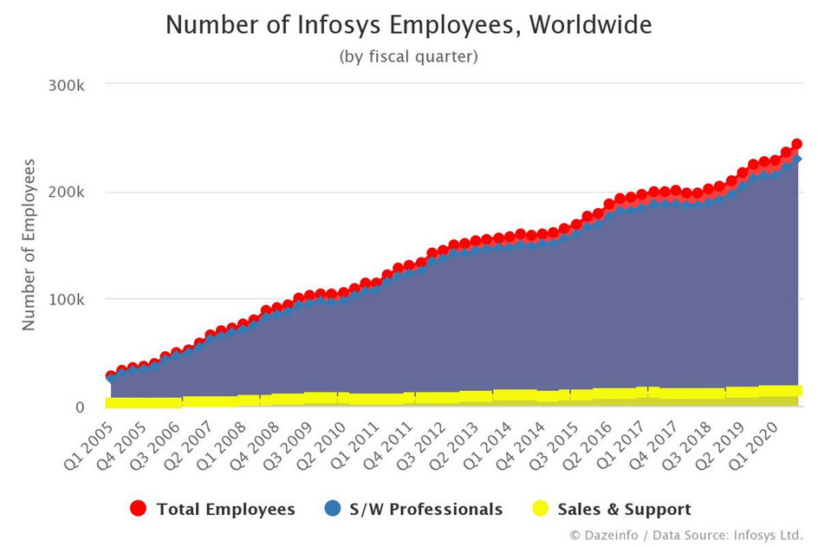
Employee Base (Country wise)
01
The total number of employees who worked at Microsoft is 221,000
There are more than 345k employees who work in Infosys.
01

Slide 10





Infosys
Rankings of the company (Forbes Fortune 500.)
Microsoft
Microsoft ranked No. 14 in the 2022 Fortune 500 ranking.
2021: 33rd
2020: 47th
2019: 60th
2018: 71th
In Forbes' list of the world's top companies, Infosys comes in at number 540.
In Forbes' list of the "World's Best Regarded Companies" for 2019, Infosys came in 3rd.
According to the Everest Group PEAK matrix, it came in 2nd place.

Slide 11



Technologies used in the Company
Microsoft
Infosys
Microsoft Azure
JavaScript
jQuery
.Net WCF
nodejs
mongoDB
Microsoft SQL
Infosys uses 103 technology products and services including
HTML5
Google Analytics
jQuery
JavaScript
Java
Python
. C#

Slide 12





Major Products of the company with Clients
Microsoft
Infosys
01
The significant products of Microsoft are:
Windows XP
Visual Studio
Microsoft Office
Microsoft Azure
.Xbox 360.
Digital Marketing. Digital Experience.
Insight Applied AI.
Innovate Blockchain. Accelerate Enterprise Agile DevOps.
Assure Cyber Security.
01

Slide 13



Major Services by the company with Clients
Microsoft
Infosys
Web applications
Universal banking solutions with various modules for retail and corporate banking.
Business applications
AI-based applications Digital marketing
Big data
Cyber security
Microsoft Azure
MS Office 365
Microsoft SQL Server
Microsoft Visual Studio
MS Windows Intune
01
01

Slide 14
Microsoft
Operational verticals of the company with clients
Infosys
Microsoft Search has two types of verticals, out-of-the-box or default, and custom verticals.
The default verticals, such as All
Files, and People, create easy access to the most commonly used search results.
High Technology. Industrial Manufacturing. Information Services & Publishing.
Life Sciences.
Logistics & Distribution.

Slide 15
Role(s) you are interested in the company
Microsoft
Infosys
Software Engineer Product Manager Data Scientist
Technical Program Manager Product designer
Cloud Software Engineer
Backend developer Full stack developer Frontend developer Software developer Digital specialist Cyber Security Program Manager

Slide 16

Packages offered by company for role(s)
Software Engineer fresher
Software Engineer
Experience: 1 - 9 yrs.
Senior Software Engineer Experience: 5 - 15 yrs.
SupportEngineer Experience: 3 - 10 yrs.
SDE (Software Development Engineer) Experience: 0 - 10 yrs.
3.80 LPA
13.1 LPA
19.0 LPA
8.0 LPA
15.5 LPA
Full-stack developer Experience: 1-2 years
8.50 LPA
Software trainee Experience: 1-2 years
3.60 LPA
Senior System Engineer (SSE)
4.60 LPA

Slide 17



Visits company gave to LPU campus
Microsoft
Infosys
Microsoft has visited the LPU campus many times for placement purposes.
It has offered both technical and non-technical jobs.
Recently Microsoft selects LPU student at ₹42 lakh package.
Infosys recruits students in mass at LPU.
But payscale is very less and workload is more.
It offers salaries starting from 4-5 LPA to 10 LPA Through Campus Placement.

Slide 18



Pros & Cons of the company you have considered for you
Microsoft
Infosys
Pros:
This company provides its employees with a full range of health benefits.
The standard 40-hour workweek is a highlight for
many.
Working for one of the top technology companies globally allows employees to have advanced tools and resources at their disposal.
Cons:
Those who work on the Microsoft campus can feel isolated from the outside world.
One issue that many people have working with Microsoft is boredom.
Many employees reported that they hardly communicated with other departments.
There are some benefits to working for Infosys, including:
Best training
Less stressful work Good facilities
The work environment is good
Some Cons of Infosys:
Random project distribution;
Freshmen are paid less than employees at other companies.
You have to maintain average working hours of 9.15 yearly.

Slide 19

List of the references weblinks, articles, etc.
Microsoft
Infosys
https://en.wikipedia.org/wiki/History_of_Mi crosoft
https://www.microsoft.com/en- us/worldwide.aspx https://www.ambitionbox.com/salaries/mic rosoft-corporation-salaries/sde-
software-development-engineer https://www.srinsofttech.com/microsoft- development.html https://www.rankingthebrands.com/Brand
-detail.aspx?brandID=4
https://en.wikipedia.org/wiki/Infosys https://alpingi.com/infosys-salary/ https://www.macrotrends.net/stocks/ch arts/INFY/infosys/revenue https://www.crunchbase.com/organizati on/infosys/technology https://catchupdates.com/starting- career-infosys-pros-cons/

